Slide 1
PHP LANDING PAGE LECTURE 2
ADNAN MAJEED
LECTURER

Slide 2


Slide 3
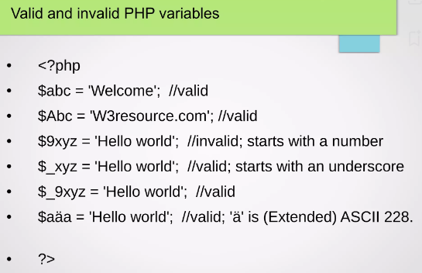
PHP variable valid and invalid

Slide 4
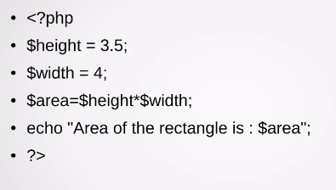
Area of rectangle in PHP

Slide 5
WHILE LOOP IN PHP
$count = 1;
while ($count <= 5) {
echo "Count is: $count <br>";
$count++;
}

Slide 6
if...else Statement
$age = 16;
if ($age >= 18) {
echo "You are an adult.";
} else {
echo "You are a minor.";
}

Slide 7
Xampp server database
Database is built in xampp server no need install separately.
MySQL database is GUI based database which able to query the data from the database.

Slide 8
Create database
CREATE DATABASE EmployeeDB;
USE EmployeeDB;

Slide 9
Employee table
CREATE TABLE Employee (
EmployeeID INT PRIMARY KEY AUTO_INCREMENT,
FirstName VARCHAR(50) NOT NULL,
LastName VARCHAR(50) NOT NULL,
Gender ENUM('Male', 'Female', 'Other') NOT NULL,
DateOfBirth DATE,
Position VARCHAR(50),
Department VARCHAR(50),
HireDate DATE,
Salary DECIMAL(10, 2),
Email VARCHAR(100),
PhoneNumber VARCHAR(15)
);

Slide 10
Insert statement
-- Insert multiple records into the Employee table
INSERT INTO Employee (FirstName, LastName, Gender, DateOfBirth, Position, Department, HireDate, Salary, Email, PhoneNumber)
VALUES
(‘khalid', ‘khan', 'Male', '1985-04-12', 'Software Engineer', 'IT', '2020-01-15', 60000.00, 'john.doe@example.com', '123-456-7890'),
(‘ayesha', ‘khan', 'Female', '1990-07-22', 'Data Analyst', 'Data Science', '2019-06-20', 55000.00, 'jane.smith@example.com', '123-456-7891'),

Slide 11
Select query (display data)
SELECT * FROM Employee;

Slide 12

PHP LANDING WEB PAGE

Slide 13
INDEX.PHP
<!DOCTYPE html>
<html lang="en">
<head>
<meta charset="UTF-8">
<meta name="viewport" content="width=device-width, initial-scale=1.0">
<title>Landing Page</title>
<link rel="stylesheet" href="style.css">
</head>
<body>
<header>
<div class="header-content">
<h1>Welcome to Our Website</h1>
<p>Get the latest updates directly to your inbox.</p>
<form action="process_form.php" method="POST">
<input type="email" name="email" placeholder="Enter your email" required>
<button type="submit">Subscribe</button>
</form>
</div>
</header>

Slide 14
<section class="features">
<h2>Our Features</h2>
<div class="feature-list">
<div class="feature-item">
<h3>Feature 1</h3>
<p>Brief description of Feature 1.</p>
</div>
<div class="feature-item">
<h3>Feature 2</h3>
<p>Brief description of Feature 2.</p>
</div>
<div class="feature-item">
<h3>Feature 3</h3>
<p>Brief description of Feature 3.</p>
</div>
</div>
</section>
<footer>
<p>&copy; <?php echo date("Y"); ?> Your Website. All rights reserved.</p>
</footer>
</body>
</html>

Slide 15
STYLE.CSS
* {
margin: 0;
padding: 0;
box-sizing: border-box;
font-family: Arial, sans-serif;
}
body {
display: flex;
flex-direction: column;
min-height: 100vh;
background-color: #f4f4f4;
}
header {
background: #008cba;
color: white;
padding: 60px 20px;
text-align: center;
}
.

Slide 16
header-content h1 {
font-size: 2.5rem;
margin-bottom: 10px;
}
.header-content p {
font-size: 1.2rem;
margin-bottom: 20px;
}
form {
display: flex;
justify-content: center;
}
input[type="email"] {
padding: 10px;
font-size: 1rem;
width: 250px;
margin-right: 10px;
border: 1px solid #ddd;
border-radius: 5px;
}

Slide 17
button {
padding: 10px 20px;
font-size: 1rem;
color: white;
background: #005f8d;
border: none;
border-radius: 5px;
cursor: pointer;
}
button:hover {
background: #004466;
}
.features {
padding: 40px 20px;
background-color: #ffffff;
text-align: center;
}
.features h2 {
margin-bottom: 20px;
font-size: 2rem;
}
.

Slide 18
feature-list {
display: flex;
justify-content: center;
gap: 20px;
flex-wrap: wrap;
}
.feature-item {
width: 200px;
padding: 20px;
background-color: #f9f9f9;
border: 1px solid #ddd;
border-radius: 5px;
}
footer {
background-color: #333;
color: white;
text-align: center;
padding: 10px 0;
margin-top: auto;
}

Slide 19
Process_form.php
<?php
if ($_SERVER["REQUEST_METHOD"] == "POST") {
$email = filter_var($_POST['email'], FILTER_SANITIZE_EMAIL);
if (filter_var($email, FILTER_VALIDATE_EMAIL)) {
// Save email to a file or database (basic example uses a file)
$file = 'subscribers.txt';
file_put_contents($file, $email . PHP_EOL, FILE_APPEND | LOCK_EX);
echo "<p>Thank you for subscribing! We've received your email: $email.</p>";
} else {
echo "<p>Invalid email address. Please try again.</p>";
}
} else {
echo "<p>Invalid request. Please go back to the landing page.</p>";
}
?>

Slide 20
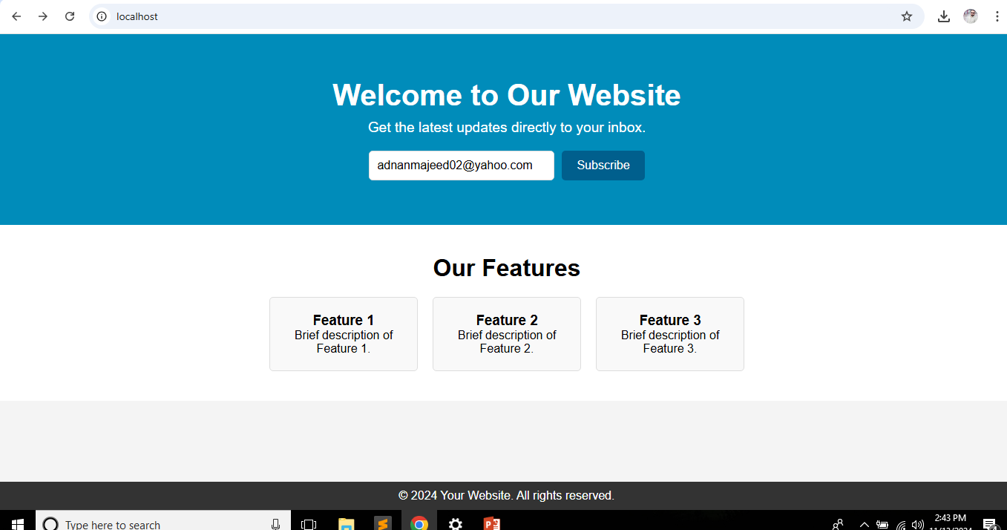
Output

Slide 21
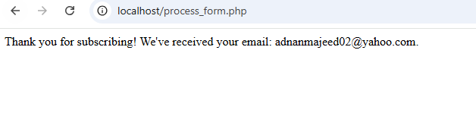
Subscription message

